Slide 1

Building Clustered Applications in a Distributed Architecture
David Sietz
Data Architect
Reference Material
https://github.com/dsietz/datadot

Slide 2
1
overview
2
multicasting
3
hook & dynamic plugins

Slide 3
1
overview
2
multicasting
3
hook & dynamic plugins

Slide 4





Overview
Trends that we have witnessed …
Business
Technology
High Availability
cloud computing
Scalability
containerization
Time To Market
Data Driven Decisions
microservices
Customer Centric Products
mapreduce
brokering

Slide 5
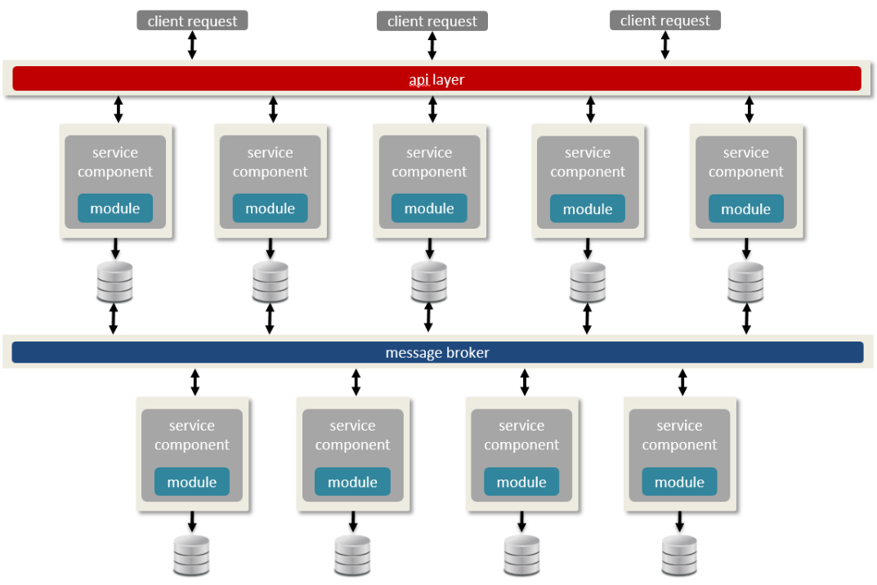
Overview
High Availability
Data Driven Decisions
Time To Market
Scalability
Customer Centric Products
Layer 1
Layer 2
Layer 3
Layer 3
Layer 2
Layer 3
Distributed Architecture
cloud computing
containerization
mapreduce
brokering
microservices

Slide 6






Clustering
Clustering databases paved the way toward distributed systems.

Slide 7
Clustering
High Performance | High Availability | Load Balancing
computation-intensive applications | failover to redundant node | shared workload between nodes
predictive modeling simulators “supercomputing” | business applications databases file shares | web server proxy server

Slide 8
Clustering
failover
management
master
load balancing
controller
master: 10.100.15.23
worker A: 10.100.15.24
worker B: 10.100.15.25
worker A: 10.100.15.24
worker B: 10.100.15.25
worker A
worker B
computation
computation
master: 10.100.15.23
worker B: 10.100.15.25
master: 10.100.15.23
worker A: 10.100.15.24

Slide 9

Distributed Architecture
client request
client request
client request
failover
management
master
load balancing
controller
api layer
master: 10.100.15.23
worker A: 10.100.15.24
worker B: 10.100.15.25
worker A: 10.100.15.24
worker B: 10.100.15.25
service
component
service
component
service
component
service
component
worker A
worker B
module
module
module
module
computation
computation
master: 10.100.15.23
worker B: 10.100.15.25
master: 10.100.15.23
worker A: 10.100.15.24

Slide 10
Clustering
High Performance | High Availability | Load Balancing
computation-intensive applications | failover to redundant node | shared workload between nodes
predictive modeling simulators “supercomputing” | business applications databases file shares | web server Proxy server

Slide 11
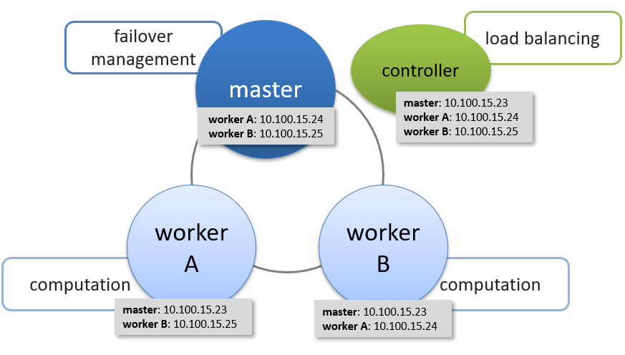
What If?
Business
High Availability
Scalability
Time To Market
Data Driven Decisions
Customer Centric Products
High Performance

Slide 12
Clustering
failover
management
master
load balancing
controller
Unicasting
point-to-point communication
master: 10.100.15.23
worker A: 10.100.15.24
worker B: 10.100.15.25
worker A: 10.100.15.24
worker B: 10.100.15.25
Specialization
single point of failure
worker A
worker B
computation
computation
master: 10.100.15.23
worker B: 10.100.15.25
master: 10.100.15.23
worker A: 10.100.15.24

Slide 13
High Performance Solutions
System Changes: Increase CPU, Memory, or Network bandwidth
Scale Horizontally: Add more nodes to the cluster
Data Retrieval: Add caching, indexing, or provision of data
Network Latency: Geographically relocate data and services
Communication: multicasting

Slide 14
1
overview
2
multicasting
3
hook & dynamic plugins
4
demo

Slide 15
Unicasting
worker
master
worker
worker
worker
worker
master
worker

Slide 16
Unicasting
worker
master
worker
worker
worker
worker
master
worker

Slide 17
Unicasting
worker
master
worker
worker
worker
worker
master
worker

Slide 18

Unicasting
PROs | CONs
security (know who’s listening) guarantee delivery TCP and UDP | must know individual communication socket (IP address and port) chatty not intended for group communication
person conversation

Slide 19
Broadcasting
worker
master
worker
worker
worker
worker
master
worker

Slide 20

Broadcasting
PROs | CONs
faster communication no prior knowledge of individual communication socket (IP address and port) intended for broad communication | security (don’t know who’s listening) no guarantee delivery chatty UDP only
public announcement

Slide 21
Multicasting
worker
source
master
worker
receivers
multicast group
worker
worker
worker
master
worker

Slide 22

Multicasting
PROs | CONs
faster communication no prior knowledge of individual communication socket (IP address and port) intended for group communication communication only with intended group | security (anyone can join the group) no guarantee delivery UDP only
user forum

Slide 23


Multicasting
What are you using it for?
When considering multicasting, make sure you understand the
Pros and Cons
quality
delivery time

Slide 24
Noninteractive Application
Usage | noninteractive applications
Example | radio broadcast, IPTV
Concerns | poor quality bandwidth variations data error/losses
Give UP | speed of delivery
Recommended Schema | Interleaving media-independent Forward Error Correction (FEC)

Slide 25
Noninteractive Application
Normal transport
0
1
2
3
4
Interleaving transport
0
1
2
3
4
0
1
1
2
2
2
3
3
4

Slide 26
Interactive Application
Usage | interactive applications
Example | IP telephony
Concerns | speed of delivery
Give UP | poor quality
Recommended Schema | media-independent Forward Error Correction (FEC)

Slide 27
Interactive Application
Forward Error Correction
Encoded Bit Sequence
Corresponding Codeword
Hamming Distance
shared by the source and receiver as agreed upon encoding
Used by the receiver to determine corrupt data and find correct encoded bits
01
00
01
11
11
10
00
10
encoder
11100
00000
11100
01111
01111
10011
00000
1001
--- transported ---
11100
10000
11110
01111
01010
10011
10011
1001
decoder
01
00
01
11
resend
10
10

Slide 28


Multicasting Pitfalls
Before jumping in, just remember …
OBJECTS IN THE MIRROR ARE CLOSER THAN THEY APPEAR

Slide 29
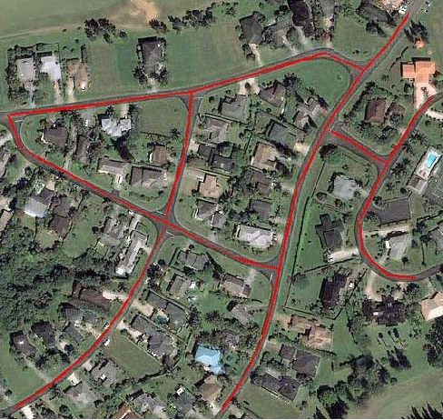
Multicasting Pitfalls
Issue
Packets delivered are not reaching the receivers
Causes
Reverse Path Forwarding (RPF) check failure because the data distribution tree is not the same as the unicast routing topology
Receivers not bound to the socket for the “group” traffic
Firewall not configured to reply transports
Senders and Receivers on different VLANs
IP Group Management Protocol (IGMP) snooping or querying not enabled on switch

Slide 30

Multicasting Pitfalls
Issue
Mimicking a DDoS attack
Causes
Switches that don’t understand multicast addresses broadcast to all LAN members
Uncontrolled bidirectional request & respond (having every listener to respond to the sender or group)

Slide 31
Multicasting Pitfalls
Issue
Multicasting doesn’t work in the Cloud
Causes
Multicasting UDP unsupported

Slide 32
1
overview
2
multicasting
3
hook & dynamic plugins

Slide 33
Where to Improve?
Business
High Availability
High Availability
Scalability
Simplified Architecture
Scalability
Time To Market
Time To Market
Data Driven Decisions
Data Driven Decisions
Customer Centric Products
Customer Centric Products
High Performance
High Performance

Slide 34
Simplify Messaging
service
module
message broker
Topic A
Topic B
activity logging
reportable data
notification service
account
mngmt
module
module
module
module

Slide 35
Simplify Messaging
source
service
module
best for unidirectional data flow
group = topic
added receivers dynamically
multicast group
receivers
receivers
activity logging
reportable data
notification service
module
module
module

Slide 36
Simplify Deployments
source
service
module
intermittent outage
blue/green = bundled deployment
complexity of deploy & rollback
multicast group
receivers
receivers
activity logging
reportable data
notification service
notification service
module
module
module
module

Slide 37
Simplify Deployments
source
service
module
plugin model
simplified deployment
no stopping the runtime
multicast group
receivers
receivers
activity logging
reportable data
notification service
plugin
plugin
plugin
plugin

Slide 38
Plugin Pattern
process flow
hook
hook
hook
plugin
plugin
plugin

Slide 39

Plugin Pattern
register the plugin
application parses plugin at every event flow
plugin
Works for interpreted scripting languages, (e.g.: PHP, Perl).
However, compiled languages (e.g.: Rust, Go, Java) parse the code during build time, not during run time.

Slide 40
Plugin Pattern
Interpreted Scripting Application
Executable Application
call to plugin
Process flow
Process flow
plugin
executable plugin
Dynamic Libraries
*.so = Linux
*.dylib = Mac
*.dll (Windows)

Slide 41
Hooks & Plugins
Executable Application
call to plugin
Process flow
executable plugin

Slide 42

Hooks & Plugins
hook
call to plugin
process_command = fn(message: &[u8], data: &json::JsonValue) -> json::JsonValue
Foreign Function Interface
fn process_command(message: &[u8], data: &json::JsonValue) -> json::JsonValue
plugin
executable plugin

Slide 43
Making It Dynamic
Executable Application
call to plugin
Process flow
executable plugin
executable plugin
After the plugin has been loaded …
we need to notify the application to reloaded the new plugin version …

Slide 44
Managing Plugin Versions
Executable Application
initialize
Plugin Manager
plugin
plugin
plugin
plugin
plugin
plugin
plugin
plugin

Slide 45


Managing Plugin Versions
Executable Application
reload
plugin
Plugin Manager
plugin
plugin
continuous
monitoring
scheduled reload
plugin
plugin
plugin
plugin
plugin
plugin
plugin

Slide 46
Managing Plugin Versions
Executable Application
reload
plugin
Plugin Manager
plugin
plugin
Plugin Manager
listening socket
{ “plugin”: “D”, version”: “2.0”}
plugin
plugin
plugin
plugin
plugin
plugin
plugin

Slide 47
Dynamic Plugin Pitfalls
Before jumping in, just remember …
OBJECTS IN THE MIRROR ARE CLOSER THAN THEY APPEAR

Slide 48

Dynamic Plugin Pitfalls
Issue
Reload plugin is occurring too often, or when it’s not needed
Causes
No authentication/authorization on the socket listener
DDoS attack crashes the listening service

Slide 49

Dynamic Plugin Pitfalls
Issue
Plugin cannot be loaded
Causes
Plugin executables (e.g.: *.dll, *.dylib, *.so) are shared and locked by another applications
Permissions on the plugin executables

Slide 50

Dynamic Plugin Pitfalls
Issue
Plugin doesn’t work when loaded
Causes
Inconsistent Foreign Function Interface (FFI)
Plugin not managed like the application – automated testing
Plugin repository is not secure and executable has been tampered with

Slide 51
Multicasting & Dynamic Plugins
Business
High Availability
Scalability
next competitive differentiator
Time To Market
Data Driven Decisions
Customer Centric Products
High Performance

Slide 52
Multicasting & Dynamic Plugins
High Performance
better code
Architecture
more CPU
multicasting
cluster management
more memory
message brokering
faster I/O
plugin reloads
full service deployments
more bandwidth
blue / green infrastructure
data relocation
data caching

Slide 53
1
overview
2
multicasting
3
hook & dynamic plugins

Slide 54
1
overview
2
multicasting
3
hook & dynamic plugins

Slide 55
picture by - 1314:Freepik.com icons by -www.flaticon.com Error Detection and Correction 3: Forward Error Correction on youtube.com

